Slide 1
How a CPU works

Slide 2
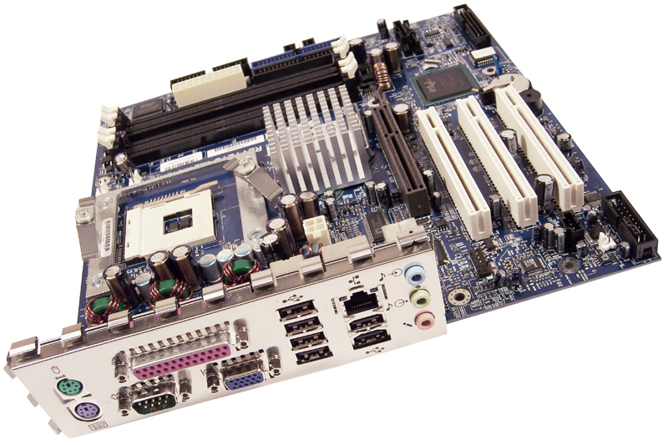
A look inside at the system main board
RAM slots
The CPU socket

Slide 3
How a CPU works
Video
https://www.youtube.com/watch?v=cNN_tTXABUA

Slide 4

Who are two manufacturers of CPUs?

Slide 5
Working with Data
Where does the CPU get data from?
Memory (ram)
What does RAM stand for?
Random Access Memory
RAM consists of two lists of numbers:
Addresses and Data

Slide 6
Control Wires
What wire does the CPU turn on when it wants to read from memory?
Enable wire
What wire does the CPU turn on when it wants to write to memory?
Set wire

Slide 7
Memory Contents
What four types of data are stored in RAM?
Numbers
Instructions
Addresses
Characters

Slide 8
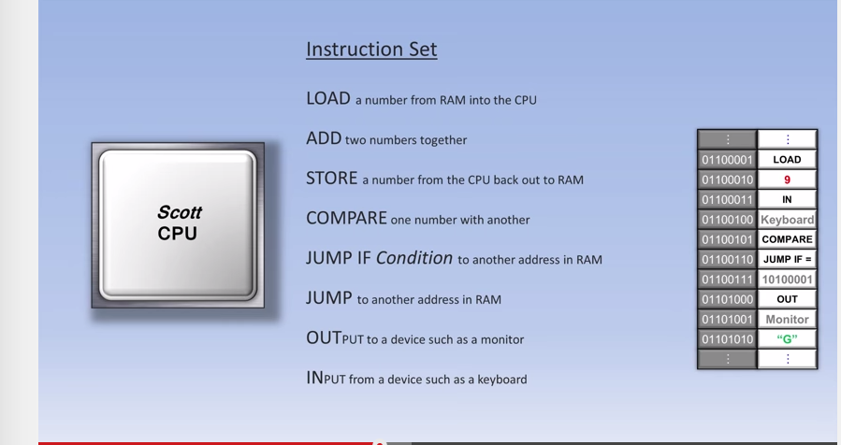
What 8 common instructions can a CPU execute?

Slide 9
Parts inside the CPU
What does the control unit do?
Processes instructions of a program
What does the ALU unit do?
Math functions – add, subtract, multiply, divide, compare
What is a register?
Small memory unit inside the CPU
What is a bus and what does it do?
The bus is a set of parallel wires that connects parts of the CPU.

Slide 10
Long-Term Data Storage
What happens to the data in RAM when the power is shut off?
The RAM is erased when the power is off.
Where is data stored when the computer is powered off?
The hard disk drive can store data without being powered on.

